Slide 1
Worksheets for students
8. TSA of cubes and prisms

Slide 2
Activity 1 Surface Area
Calculate the Surface Area of the cube and cuboids shown below:
15cm
7cm
3cm
EXTENSION:
8cm
9cm
6cm
12cm
5cm

Slide 3
Activity 2 Surface Area
Calculate the surface area of the following shapes.
5cm
9cm
14m
3cm
6cm
4cm
1m
2m

Slide 4
Find the surface area of the following shapes
6m
4cm
5m
4m
3cm
7cm
9m
5m
7cm
8cm
11cm
9cm

Slide 5
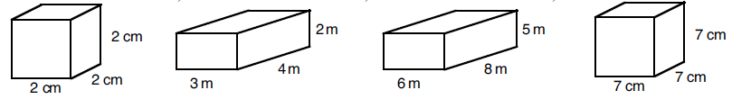
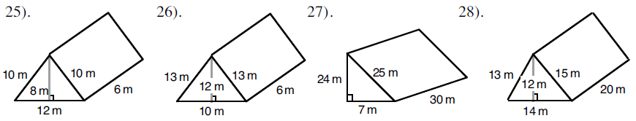
1.
2.
4.
3.
5.
6.
7.
8.
9. Katy wants to wrap a present that is 15cm wide, 18cm deep and 4cm high. How much wrapping paper will she need to use?
10. A length of copper piping is in the shape of a triangular prism. The triangle on it’s end is 9mm tall, 4mm wide. The piece of pipe is 18cm long. What is the surface area of the pipe?
11. A box has no lid. The box measures 1.2m by 30cm by 45cm. What is the surface area of the outside of the box?

